Slide 1
Optimising Taxi Operations
Johnny Chan Fan Hui

Slide 2
Context and Objective
Background
Relax Delgro Group is a private transportation group that is based in New York.
Its business model revolves primarily leasing taxi fleet to franchised vendor and providing business/analytics support to vendors to maximize trip completion and in turn, increasing demand for Relax Delgro's fleet renting.
Other revenue source includes operating supporting infrastructure such as fleet servicing station, EV/patrol refueling points and resting areas.
Objective
1) To provide timely intelligence to optimize deployment of Taxis
2) To strategize the placement of supporting infrastructure for maximum return of investment
3) To formulate targeted lobbying initiative with local governor for increased profit
4) To monitor vendor's performance and help formulate outreach programme to maximize profit

Slide 3
Scope
Dashboard Features
01
02
Fleet Ops Optimization
Profit Opportunity
03
Errant Practices
04
05
Discussion

Slide 4
01
Dashboard Feature

Slide 5
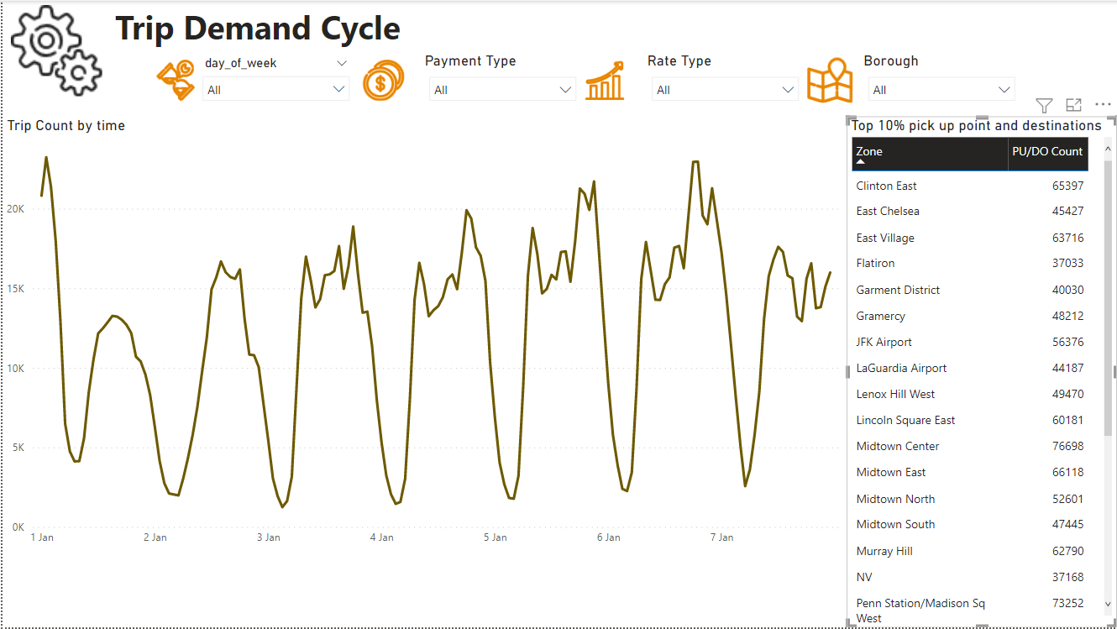
1. Ops Monitoring
1. Drop Down Filters
3. Top 10% pick up / drop off zones by trip count
clicking individual zone will reveal ops tempo in time-series visual (2) in the dashboard
2. Time Series Ops Tempo

Slide 6
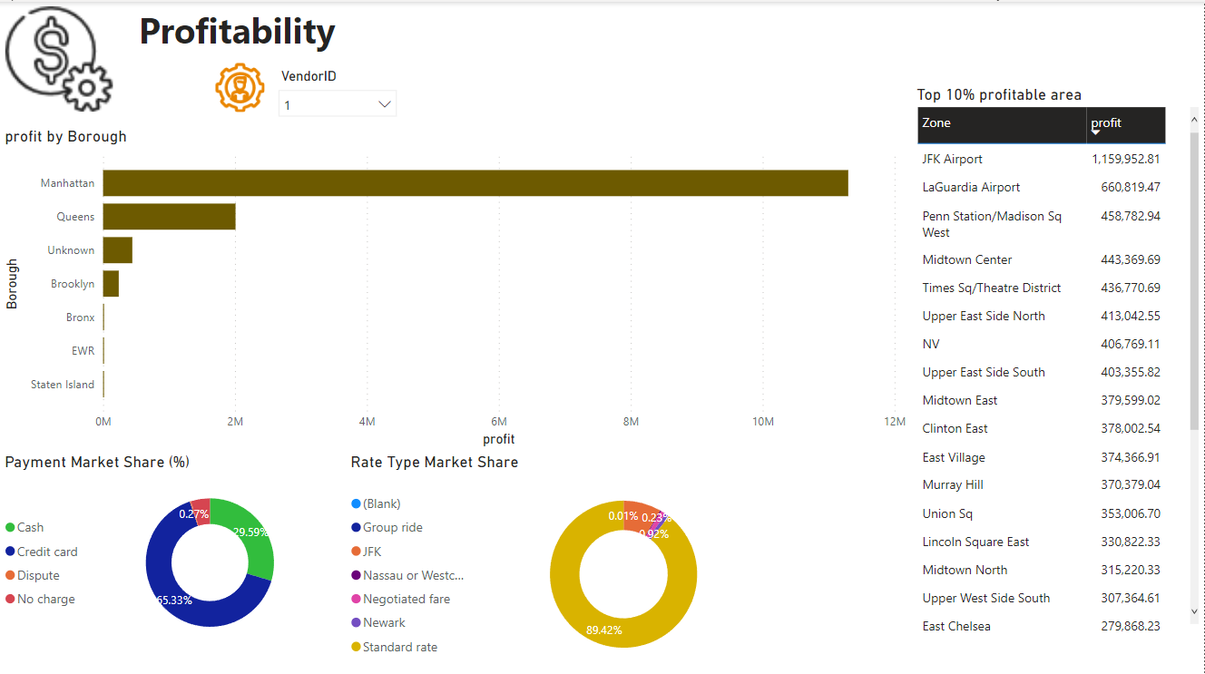
2. Vendor Profitability Monitoring
1. Drop Down Filters
3. Top 10% pick up / drop off zones by trip revenue
2. Revenue by Borough
(revenue is defined by total charge with toll charge deducted)
4. Market share of payment type / rate

Slide 7
02
Fleet Optimization

Slide 8
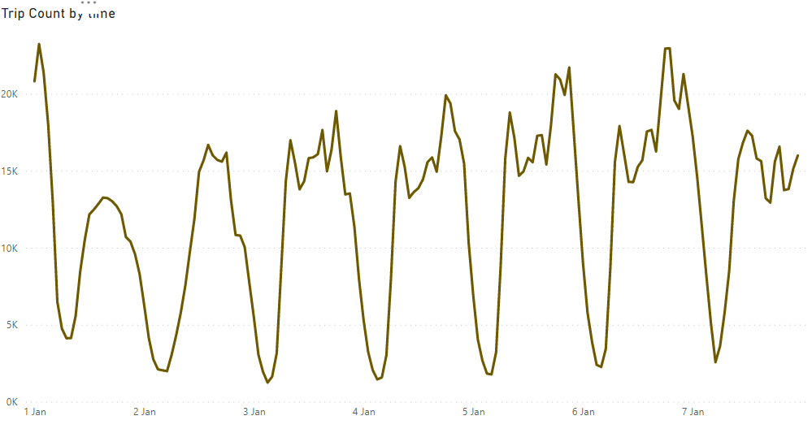
Daily Ops Cycle
With the exception of New Year Eve’s Midnight, Taxi Demands starts pre-sunrise, ramps up towards 6pm and reduce to minimal past 12am (although past-midnight demand on weekends are higher than weekdays)

Slide 9
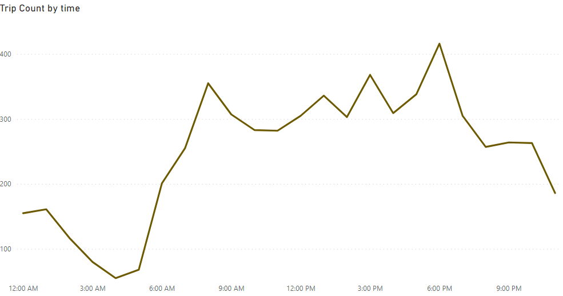
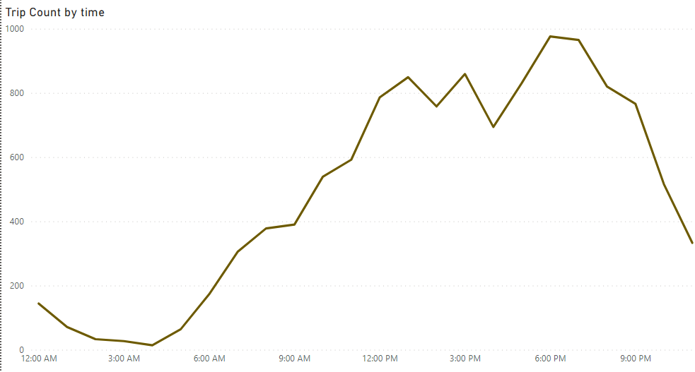
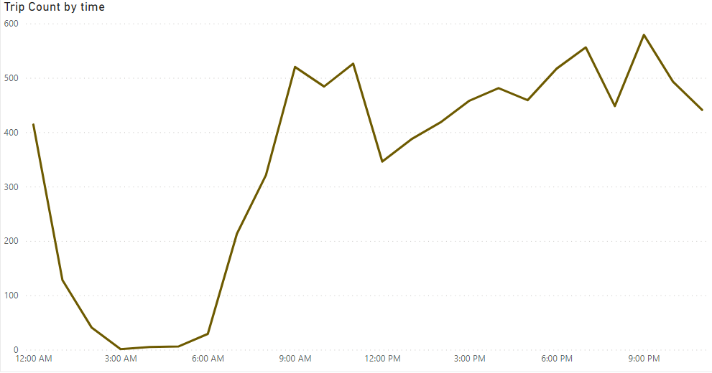
District Segmentation
Not all zones behaves the same. 3 broad patterns are identified. 1) Business/Residence Distrinct, 2) Shopping/Night Life District, 3) Evergreen Districts
Eg. East Chelsea
Eg. Midtown Center
Eg. Airports
Business/Residence districts ramp up at predawn hours and tapers off after office hours
Shopping/Night Life districts ramps up at noon and tapers off after 9/10pm
Evergreen districts Ramps up pre-dawn and peaks past midnight

Slide 10
Fleet Optimising Strategy
1
Lobby for time-activated location surcharges for high demand Zone
Dynamical swing taxi fleet between district at critical time intervals
a. Pricing strategy at EV/Petrol station to attract Taxis to district
b. Promotion at zone’s rest station/canteen
2
3
Increase/Decrease infrastructure build to reap maximum ROI

Slide 11
03
Revenue Generating Opportunity

Slide 12
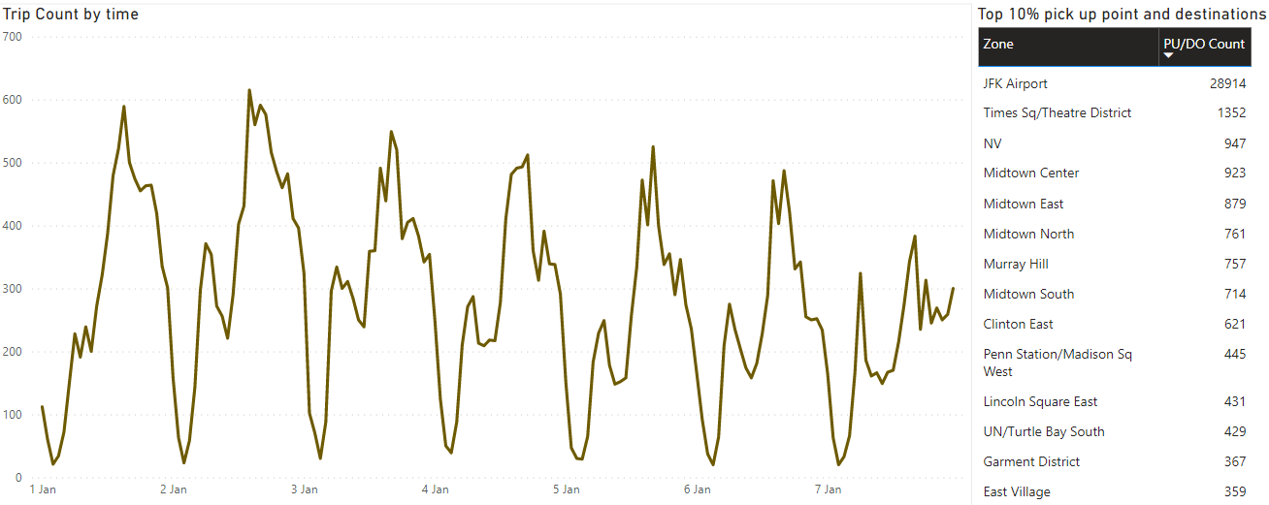
Popular Airport Route
Filtering by Airports, the zones within blue boxes below indicates popular pick up and drop off point from airport. It is assessed that these areas are popular business / tourist locations

Slide 13
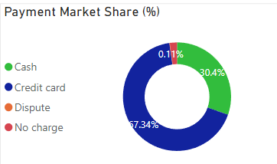
Payment Mode
The main payments methods are 1) Credit Card (68%) and 2) Cash (30.4%)

Slide 14
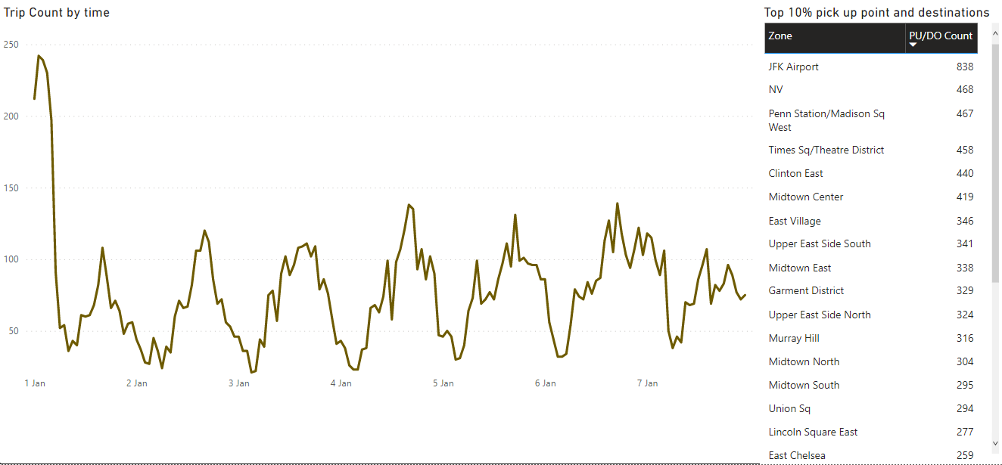
Over Pricing and Haggling
Over Charging and Haggling indicates 1) over demand and extreme under supply, 2) exploitation of ignorant consumers. Filtering the payment by “no charge” and “dispute”, the location in blue box indicates lack of competition in the area. More supply of taxi can be injected
The spike in such payment strategy on new year new midnight indicates extreme under supply after the count down party

Slide 15
Revenue Opportunities
1
Surcharge to airport from popular locations could be enacted
Strategic partnership with credit card companies
a. Joint-card with cash rebate benefit
b. Credit card advertisement placement on/in taxis
2
3
As there is under demand, price elasticity study to be conducted on cab rental to maximize fleet size vs rental revenue
4
Incentive for ex-cab drivers to rent car for short term during popular holiday period

Slide 16
04
Errant Behavior Detection

Slide 17

Categorical Variables
Filtering by vendor, only vendor 1 is receiving revenue through no-charge / disputed means
These payments method comprises 0.27% of total transaction

Slide 18
Errant Behavior
1
Invoke fine on errant drivers
2
Work with vendor 1 to ramp up recruitment

Slide 19
05
Discussion

Slide 20
Thank you

